Slide 1

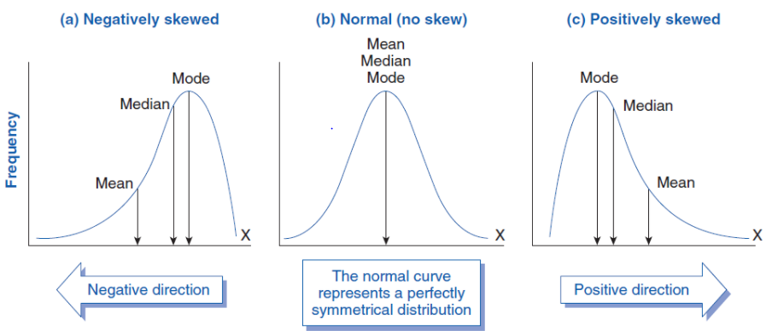

Slide 2

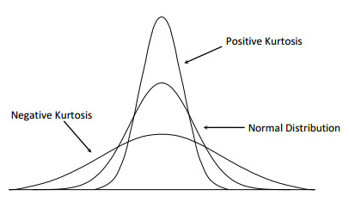

Slide 3

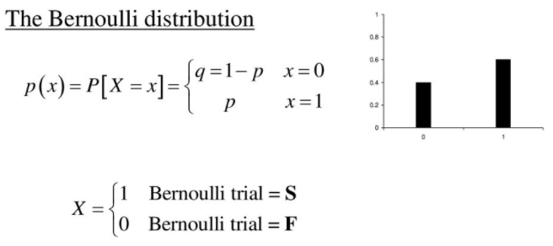
The Bernoulli distribution is a discrete distribution having two possible outcomes labelled by and in which ("success") occurs with probability and ("failure") occurs with probability.

Slide 4

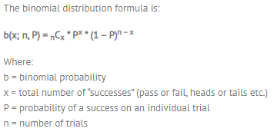
Binomial distribution is a common probability distribution that models the probability of obtaining one of two outcomes under a given number of parameters.

Slide 5
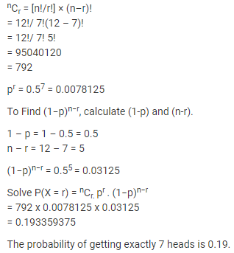
Toss a coin for 12 times. What is the probability of getting exactly 7 heads?
Solution:
Number of trails (n) = 12
Number of success (r) = 7
probability of single trail(p) = ½ = 0.5

Slide 6

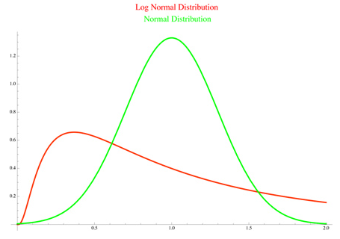
In probability theory, a log-normal distribution is a continuous probability distribution of a random variable whose logarithm is normally distributed

Slide 7

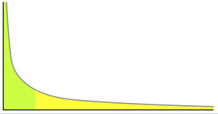
In statistics, a power law is a functional relationship between two quantities, where a relative change in one quantity results in a proportional relative change in the other quantity, independent of the initial size of those quantities: one quantity varies as a power of another.
It follows 80/20 rule. Ex. 80% of the marks can be obtained from 20% of the syllabus.

Slide 8

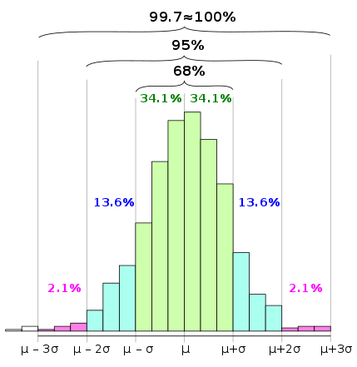
In statistics, the 68–95–99.7 rule, also known as the empirical rule, is a shorthand used to remember the percentage of values that lie within an interval estimate in a normal distribution: 68%, 95%, and 99.7% of the values lie within one, two, and three standard deviations of the mean, respectively.

Slide 9

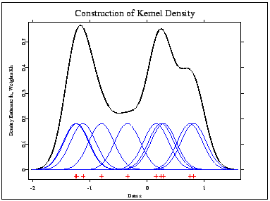
kernel density estimation is a non-parametric way to estimate the probability density function of a random variable. Kernel density estimation is a fundamental data smoothing problem where inferences about the population are made, based on a finite data sample.

